Slide 1
2023 Industrial Collaboration Programme
Briefing Session and Q&A
22nd May 2023
12:30 – 1:30

Slide 2
Before we start:
This session will be recorded and made available on the Royce website, please do share this recording with your contacts
Q&A Button: Please add questions during the course of the webinar and these will be answered either at the end of the meeting (or afterwards via the frequently asked Q&A notes)

Slide 3
Royce – Industrial Collaboration Programme (ICP)
This is the third iteration of the Royce ICP funding programme.
The Royce ICP aims to:
Support industry-academic collaborations,
Help industry solve industrial problems and promote UK growth,
Previous ICP projects have:
Aided the development and optimisation of products,
Helped companies create jobs through supporting R&D,
Allowed companies to bring in new investment through proven results,

Slide 4
Summary:
Royce Industry Collaboration Programme (ICP) 2023
Focused on short term (1st October 2023 - 29th February 2024), collaborative RD&I projects that should explore innovative ideas with a focus on technology translation. Projects must:
Be between £75k-£125k and incur costs within the project’s duration
Must include at least one business and at least one university or RTO,
Carry out the work and intend to exploit the results in the UK,
Be a new project or activity that has not already started,
Must run between the 1st of October 2023 – 29th February 2024,
Participation of Royce partners & facilities in projects is optional but strongly encouraged.
It is anticipated that a minimum of £2M of funding will be awarded.
Application Deadline: 5pm, 30th June 2023
Further details available on the Royce Website

Slide 5
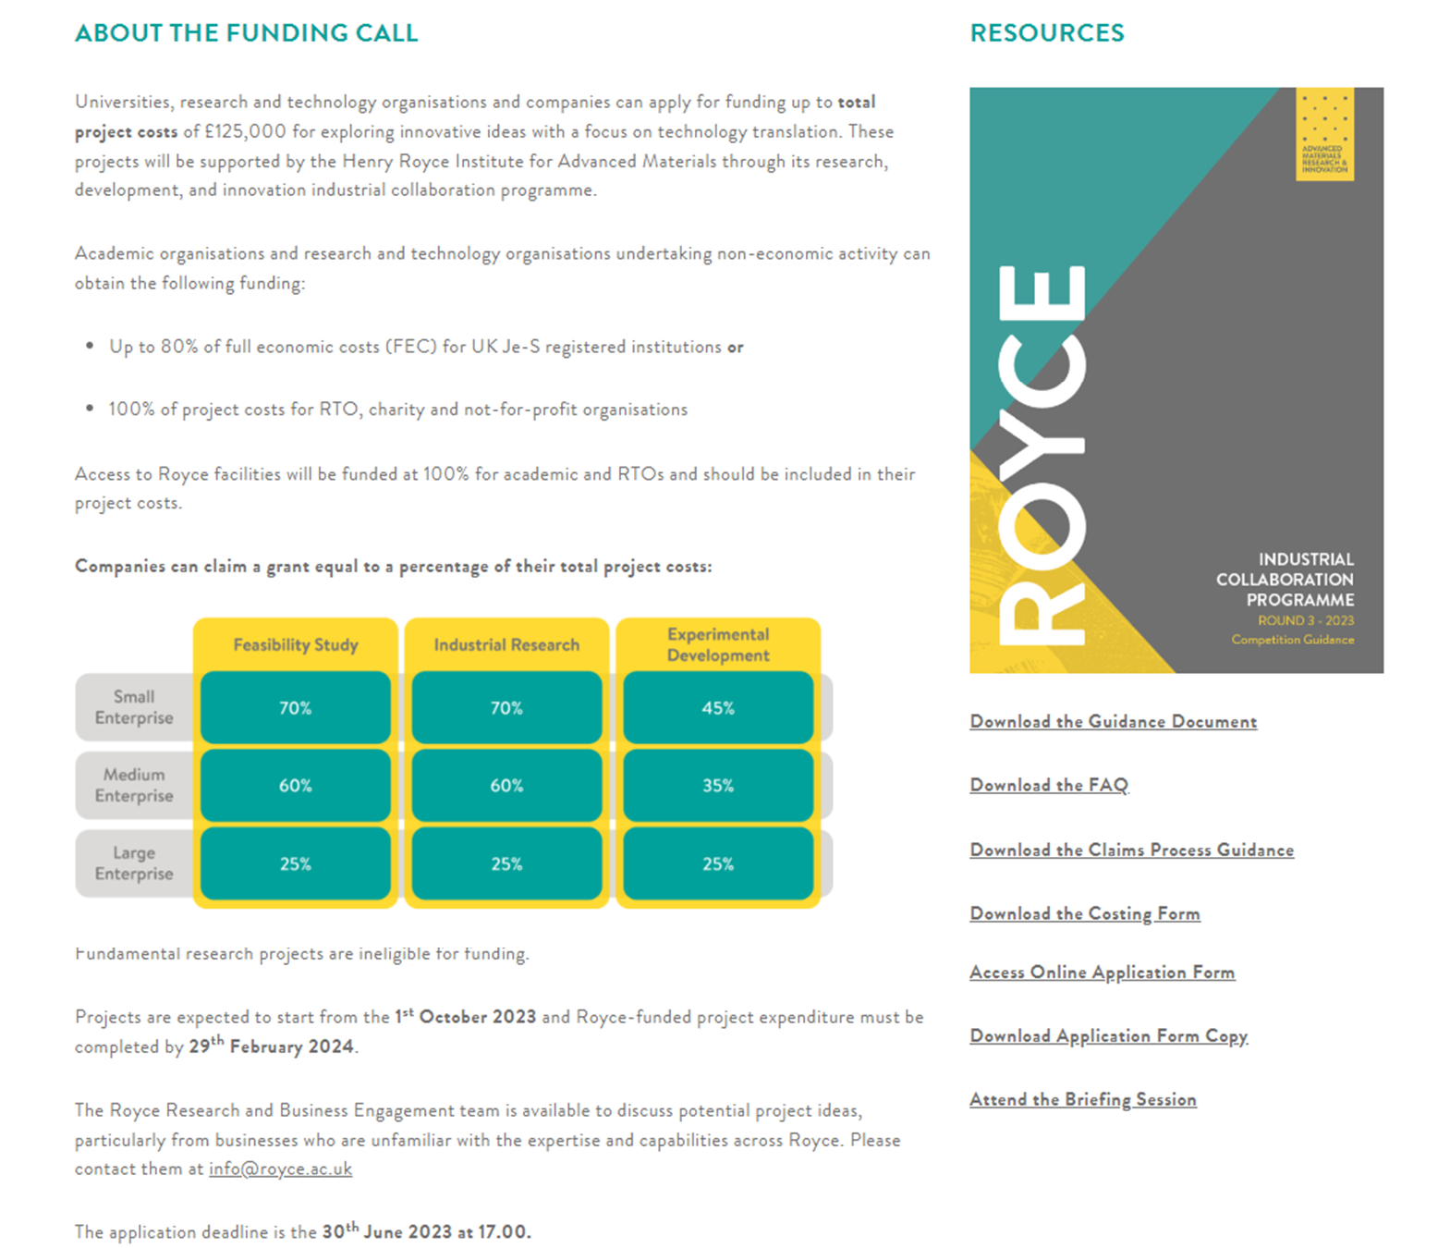
Royce Industry Collaboration Programme (ICP) 2023
Further details available on the Royce Website
Application Deadline:
5pm, 30th June 2023

Slide 6
Who Can Participate:
To collaborate or lead, you must be one of the following:
Academic institution
Research and technology organisation (RTO),
Charity or not for profit organisation
Business of any size
UK registered companies may participate and claim funding. International companies are eligible for participation but cannot claim funding.
Application Deadline: 5pm, 30th June 2023
Further details available on the Royce Website

Slide 7
Who Can Participate:
Project leads can be:
An appropriate senior manager from industry
A researcher holding an academic position (e.g. lecturer or equivalent)
Holders of early career fellowships whereby the university grants you the same stature
as a permanent academic staff member.
University or research and technology organisation technical professional services staff
(e.g. Technical facility experimental leads and technical specialists or equivalent)
Postdoctoral fellowships are ineligible.
Principal Investigators can lead one proposal and collaborate on one additional proposal.
Application Deadline: 5pm, 30th June 2023
Further details available on the Royce Website

Slide 8
Competition Scope
Projects must fall within the following scope areas:
Hydrogen
Biomaterials, Bioprinting and Bioelectronics
Low-loss electronics
Materials 4.0
Foundation industries
The full details are given in the Competition Guidance Document
It is up to the applicant to demonstrate in their proposal how their project fits the competition scope as defined in the competition guidance.
Application Deadline: 5pm, 30th June 2023

Slide 9
Funding Model
The grant awarded to successful projects covers a proportion of the project partners eligible costs. The grant amount is determined by the type of recipient (University, RTO, or business).
Academic organisations and RTOs undertaking non-economic activity can obtain funding:
Up to 80% of full economic costs (FEC) for UK Je-S registered institutions or
100% of project costs for RTO, charity and not-for-profit organisations
Access to Royce facilities will be funded at 100% for academic institutions and RTOs and should be included in their project costs.
 | Feasibility study | Industrial research | Experimental development
Small Enterprise | 70% | 70% | 45%
Medium Enterprise | 60% | 60% | 35%
Large enterprise | 25% | 25% | 25%
Companies can claim a grant equal to a percentage of their total project costs depending on their size and the project’s research, development and innovation classification

Slide 10
Royce Support- Application Scientists
Dedicated Royce application scientists have been recruited by to support short-term industry-led project delivery. The application scientist team is available as a shared resource and can be costed into proposals where dedicated support does not exist.
Application scientists are available in the following thematic areas and locations:
Manchester: | Biomaterials, fibre technologies and additive manufacturing.
 | Evaluation of materials for demanding environments
 | Sustainable polymer synthesis and end-of-life
 | Materials chemistry/foundation industries
 | Textile engineering
Oxford: | Electrochemical systems
Sheffield: | Advanced metals processing
 | Functional films and ceramics
Liverpool: | Materials design, high throughput robotics

Slide 11
Eligible costs- Academia
Item | Eligible cost | Notes
Directly incurred: | PDRA costs | Should be an existing staff member
 | Consumables and minor equipment | The maximum individual consumable cost is £10k
 | Equipment usage | Costings should be obtained from the appropriate facilities manager Contact info@royce.ac.uk Royce facilities are funded at 100% FEC.
 | Capex | <20% of total project costs can be allocated to buy or enhance a Royce facility
 | Travel and subsidence | Max £5k
 | Training and development | Max £5k
 | Events and outreach | Max £2k
 | Subcontractor | With prior agreement
Directly allocated: | Investigator time
 | Technician, technical specialist
 | Application scientists
Indirects | Estates, technician IS and other costs

Slide 12
Eligible costs- Industry, RTOs, Charities
Eligible cost | Notes
Labour | PAYE costs only
Overhead | The Royce funds a flat 15% rate for labour for overheads only.
Materials and minor equipment | Maximum individual consumable cost is £10k. All items procured under this category must be used solely for research and not for commercial purposes.
Capital expenditure (>£10k) | Ineligible
Capital usage / equipment usage | Allowed as per UKRI guidance
Subcontractor costs | With prior agreement
Travel and Subsistence | Max £5k

Slide 13
Application Process
All applicants must complete an online application form and costing sheet.
If a project partner does not wish to claim grant funding or wishes to provide in-kind or cash contribution towards the total project costs, it should outline this on a company letterhead document signed by a senior company official.
A Collaboration Agreement must be signed prior to the start of the project
Application Deadline: 5pm, 30th June

Slide 14
Assessment Criteria
Your application will be confidentially shared with, and assessed by an independent panel made up of experts in the field from industry and academia against the following criteria:
The idea and potential for a substantive step-forward,
Ability to deliver a high-impact project,
Ability to give added value to a scope area,
Appropriate project resources and capabilities,
Appropriate work plan and ability to complete by 29th February 2024,
Justification of costs and value for money,
Overall fit to Royce funding objectives,

Slide 15
Timeline
Announcement
Call open
Briefing Event
Application Deadline*
Application Outcome
Projects Start
2nd May
2023
15th May
2023
22nd May 2023
30th June
2023, 5pm
31st July
2023
From 1st October
2023
* Submission must be made via the online form

Slide 16
Contact Details
Please email any queries to: info@royce.ac.uk
To apply please visit https://www.royce.ac.uk/industrial-collaboration-programme/

